Slide 1
Tune the query, not the plan
Kevan Riley

Slide 2





Kevan Riley
Independent/freelance/contractor/consultant
17+ years SQL Server
kevan.riley@rileywaterhouse.co.uk
@kevriley
Notes:
Contact details at end also
RG – prize draw, books
Community

Slide 3
Execution plans
Generated by Query Optimizer
Cardinality Estimator
Statistics
YOUR design
How SQL will execute the query
Table access
What order
Join algorithm
VERY useful in performance tuning

Slide 4
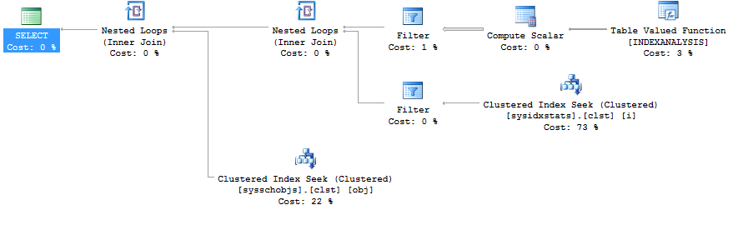
Execution plan

Slide 5
So what’s the problem?
DBA firefighting
Looking for quick wins
Focus on ‘bad’ operators
Table Scans
Scan operations in general (prefer seek)
Sort

Slide 6
DEMO
Evil Table Scans

Slide 7
Index structure
intermediate
leaf
root

Slide 8
Person.Person PK_Person_BusinessEntityID
1 (root)
8
3809 (leaf)
=================
3818

Slide 9
DEMO
Evil Scans (in general)

Slide 10

So which operators then?

Slide 11
Warnings
Memory
SpillToTempDb
Wait
SortSpillDetails - new 2016 (2012sp3 2014sp2)
HashSpillDetails - new 2016 (2012sp3 2014sp2)
Notes:
ColumnsWithNoStatistics *
SpillToTempDb
Wait
PlanAffectingConvert
SortSpillDetails - new 2016 (2012sp3 2014sp2)
HashSpillDetails - new 2016 (2012sp3 2014sp2)
https://support.microsoft.com/en-gb/kb/3107400
NoJoinPredicate *
SpatialGuess
UnmatchedIndexes
FullUpdateForOnlineIndexBuild
*pre 2012
http://schemas.microsoft.com/sqlserver/2004/07/showplan/

Slide 12
Warnings
Indexes
PlanAffectingConvert
Cardinality Estimate
Seek Plan
UnmatchedIndexes - Filtered Indexes
Notes:
ColumnsWithNoStatistics *
SpillToTempDb
Wait
PlanAffectingConvert
SortSpillDetails - new 2016 (2012sp3 2014sp2)
HashSpillDetails - new 2016 (2012sp3 2014sp2)
https://support.microsoft.com/en-gb/kb/3107400
NoJoinPredicate *
SpatialGuess
UnmatchedIndexes
FullUpdateForOnlineIndexBuild
*pre 2012
http://schemas.microsoft.com/sqlserver/2004/07/showplan/

Slide 13
Warnings
ColumnsWithNoStatistics
NoJoinPredicate
SpatialGuess
FullUpdateForOnlineIndexBuild
Notes:
ColumnsWithNoStatistics *
SpillToTempDb
Wait
PlanAffectingConvert
SortSpillDetails - new 2016 (2012sp3 2014sp2)
HashSpillDetails - new 2016 (2012sp3 2014sp2)
https://support.microsoft.com/en-gb/kb/3107400
NoJoinPredicate *
SpatialGuess
UnmatchedIndexes
FullUpdateForOnlineIndexBuild
*pre 2012
http://schemas.microsoft.com/sqlserver/2004/07/showplan/

Slide 14


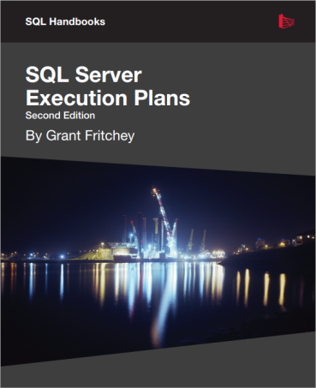
Further Resources
Redgate SQL Monitor v6
SentryOne Plan Explorer FREE!
SQL Server Execution Plans – Grant Fritchey
Notes:
Redgate SQL Monitor v6 introduces execution plans for top sql/long running
SentryOne Plan Explorer – a must have if serious about execution plan analysis. Best of all it’s free!
Grant’s book – zero to hero – download pdf for free

Slide 15
Allocation order scans
https://sqlperformance.com/2015/01/t-sql-queries/allocation-order-scans
https://blogs.msdn.microsoft.com/sqlserverstorageengine/2006/11/08/when-can-allocation-order-scans-be-used/
http://www.queryprocessor.com/nolock-and-top-optimization/

Slide 16

Thanks for listening
kevan.riley@rileywaterhouse.co.uk
www.rileywaterhouse.co.uk
@kevriley

